Slide 1
Combating marine litter in the Mediterranean: Featured MIO-ECSDE’s activities
Thomais Vlachogianni | Phd Env Chem
MIO-ECSDE Programme Officer
DeFishGear WP4 Leader
Member of the MSFD TSG 10
Member of the CORMON group

Slide 2
MIO-ECSDE | At a glance
MIO-ECSDE, is a Federation of 128 Mediterranean NGOs working in the fields of Environment and Development.
Our mission is to:
protect the Natural Environment and Cultural Heritage and
promote Sustainable Development in a peaceful Mediterranean by bringing together the efforts of environmental and developmental NGOs.
Key areas of work & main lines of activity:
Monitoring and influencing EU and regional Mediterranean policies and bodies
Drafting, promoting and presenting common NGO positions
Raising public awareness, promoting participation and building consensus
Capacity building of specific audiences
Networking, International Collaborations & Partnerships
Facilitating Mediterranean stakeholder networks
Scientific research
Resources & Waste
Health & Environment
Nature & Biodiversity
Climate Change

Slide 3
MIO-ECSDE | A network of networks
MIO-ECSDE facilitates four other networks of major Mediterranean stakeholders who play a key role in addressing the region’s environmental and sustainable development challenges:
Educators through MEdIES (Mediterranean Education Initiative for Environment and Sustainability)
Members of Parliament through COMPSUD (Circle of Mediterranean Parliamentarians for Sustainable Development)
Journalists through COMJESD (Circle of Mediterranean Journalists for Environment and Sustainable Development)
Universities through the Network of Mediterranean Universities for Sustainable Development, focusing on Education for Sustainable Development

Slide 4
Stopping marine litter together:
The MARLISCO concerted actions
Target audience: 10-15 yr old students
Structure: 18 separate leaflets containing some theory, facts and pedagogic activities, as well as worksheets. All collected in a folder, to be applied as a whole or in part.
Production: 11 languages + 3 (Albanian, Montenegrin, Croatian)

Slide 5
KNOW-FEEL-ACT to Stop Marine Litter | CONTENTS
A: GETTING TO KNOW MARINE LITTER
A1 Looking for a definition
A2 Testing Litter items
A3 Where does it come from and where does it end up
A4 Guess the top-10
B: INVESTIGATING THE SOURCES OF ML, LAND & SEA BASED
B1 “Unseen” litter around us …
B2 The travels of a litter item
B3 Going deeper … in the press
B4 Inventory on our habits
C: EXPLORING THE IMPACTS OF ML
C1 All tied up
C2 Animal tales
C3 How harmful is it?
C4 Impacts on people
C5 Can we afford marine litter?
D: Working towards solutions
D1 Policy tools to fight ML
D2 Fortune tellers…
D3 Resistance to change
D4 Joint action
D5 Going public!

Slide 6
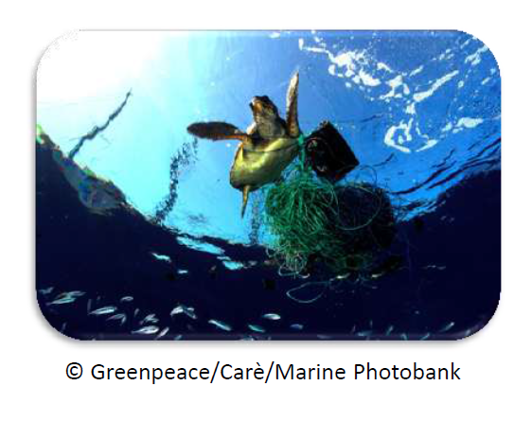
Survey on Marine Litter, Abandoned, Lost or Discarded Fishing Gear & Ghost Nets in the Mediterranean Sea
Target countries:
Morocco
Algeria
Tunisia
Egypt
Israel
Palestine
Syria
Lebanon
Turkey
Croatia
Albania

Slide 7
Enhancing citizen science initiatives
Mainstreaming citizen science into existing schemes (cleanup and awareness raising actions, educational materials);
Promoting relevant technologies (e.g. MLW)
Participating and working collectively within a think tank on citizen science & marine litter

Slide 8
Thank you!
For more info:
www.mio-ecsde.org
vlachogianni@mio-ecsde.org

