Slide 1

Conference on Sub - regional cooperation in Marine Litter management in Adriatic –Ionian sub-region
- Fishing for litter pilot activities -
Paolo Pelusi
Mediterranean Consortium

Slide 2
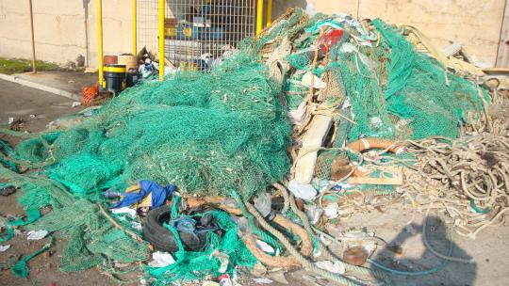
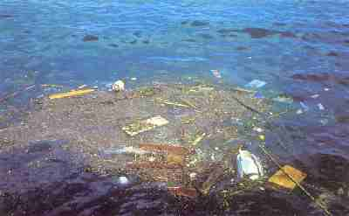
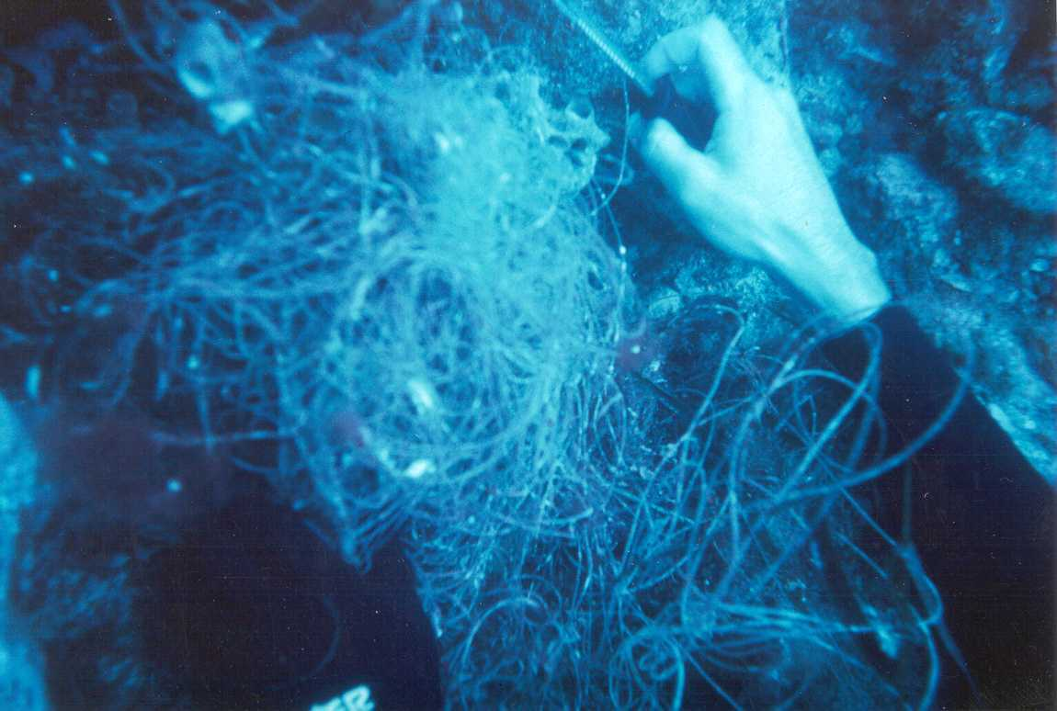
Objectives
The main objectives of these activities are to reduce marine litter pollution in the Adriatic coastal waters and collect derelict fishing gear by involving fishermen and other stakeholders in the foreseen activities.

Slide 3
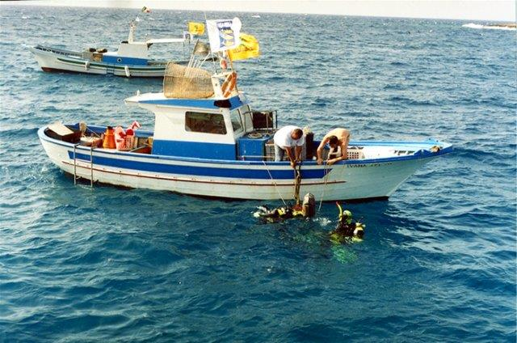
Objectives
These objectives will be achieved by setting out a system for collection and (where possible) recycling of derelict fishing gear. In addition, collection of floating litter and litter from the sea bottom, including the so called "ghost nets", are carried on in collaboration with fishermen.

Slide 4
Activities
1
Identification of common agreements and fishermen awareness campaign
2
Pilot action 1: Derelict fishing gear collection in ports for recycling
3
Pilot action 2: Fishing for litter
4
Pilot action 3: Ghost nets collection at sea
5
Protocols elaboration for the future ICZM implementation

Slide 5
Expected outcomes
Direct results
reduce marine litter pollution in the Adriatic coastal waters
setting out of a system for collection and recycling of derelict fishing gear
cleaning of the sea collecting floating litter and litter from the sea bottom, including the so called "ghost nets"
awareness on significance of the problem within the fishing sector and amongst citizens and policy-makers
guidelines elaboration for the future ICZM implementation
Indirect results
reach a restoration of coastal marine environments
improve perception of the marine environment status by fishermen
influence policy-makers on marine litter management

Slide 6
The WP6 Team
Mediterranean Consortium (Italy)
WP 6 Lead Partner
National Institute for Environmental Protection and research
(Italy)
Institute for water of the Republic of Slovenia
(Slovenia)
Institute for Oceanography and Fisheries
(Croatia)
University of Montenegro, Institute of marine biology
(Montenegro)
RDA of Lezha
(Albania)
Hellenic Centre for Marine Research
(Greece)

Slide 7
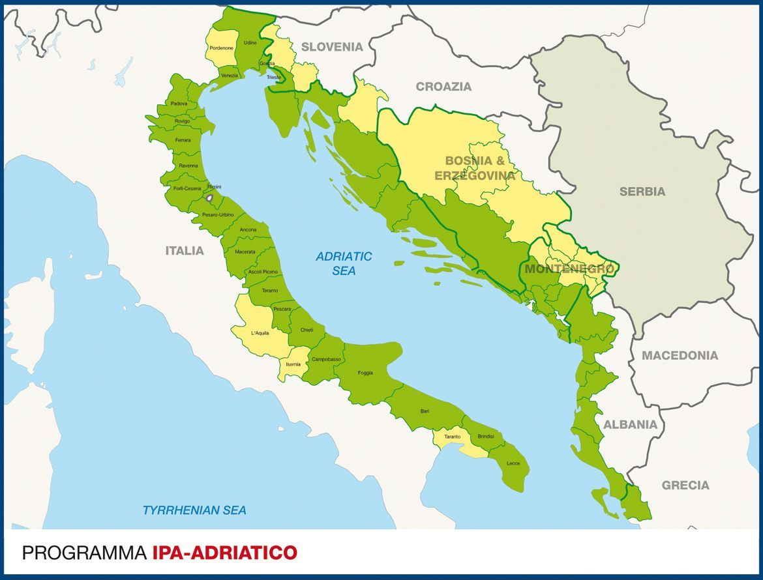
Locations
STATES/FB | Act. 6.1 | Act. 6.2 | Act. 6.3 | Act. 6.4
Italy FB 3. Mediterranean Consortium | Ancona, Molfetta, Cattolica | Ancona, Molfetta, Cattolica | Ancona, Molfetta, Cattolica | Ancona, Molfetta, Cattolica
Italy FB 1. National Institute for Environmental Protection and research | Chioggia | Chioggia | Chioggia | Chioggia
Slovenia FB 5. Institute for water of the Republic of Slovenia | Izola, Koper | Izola, Koper | Izola, Koper
Croatia FB 7. Institute for Oceanography and Fisheries (IOF) | Vira (island of Hvar), Tribunj | Vira (island of Hvar), Tribunj | Vira (island of Hvar), Tribunj | Vira (island of Hvar), Tribunj
Montenegro FB 9. University of Montenegro, Institute of marine biology | Bokakotorska Bay, Herceg Novi, Bar | Kotor, Herceg Novi, Bar | Herceg Novi, Budva, Bar | Bokakotorska Bay
Albania FB 11. RDA of Lezha | Shengjin | Shengjin | Shengjin
Greece FB 13. Hellenic Centre for Marine Research | Corfu (city) port Petriti port | Corfu (city) port Petriti port | Corfu (city) port Petriti port | Corfu (city) port Petriti port

Slide 8

Similar experiences have been carried out in Italy since 1998 by Lega Pesca, a Italian fishing association involving trawler boats of the Marche Region in collection of waste at sea.

Slide 9
DeFishGear
Identification of common agreements and fishermen awareness campaign
Agreements with:
  Fishermen cooperatives/groups
  Port Authorities
  Waste management companies
  Municipalities
  Regional authority
  Awareness campaign in each port involved

Slide 10
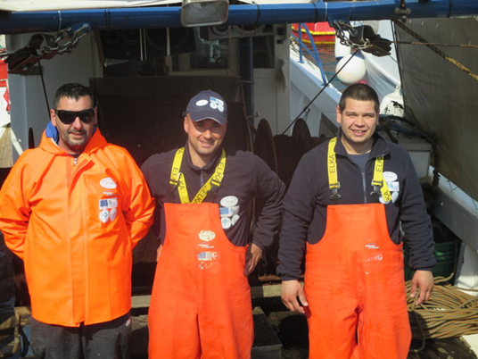
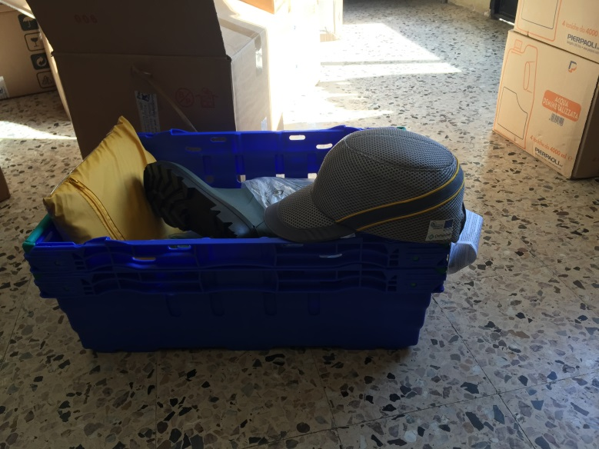
DeFishGear
Identification of common agreements and fishermen awareness campaign
Gadget purchased and distributed

Slide 11
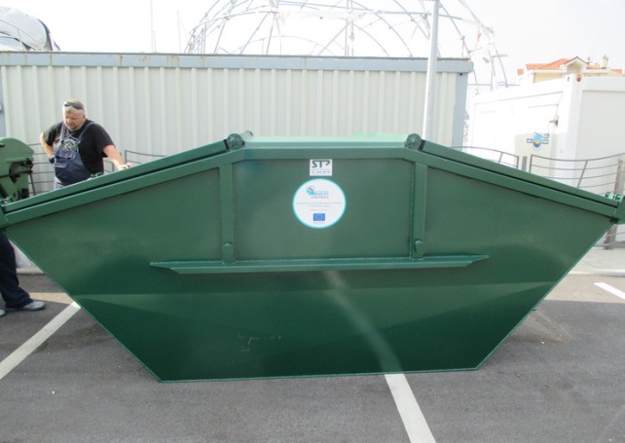
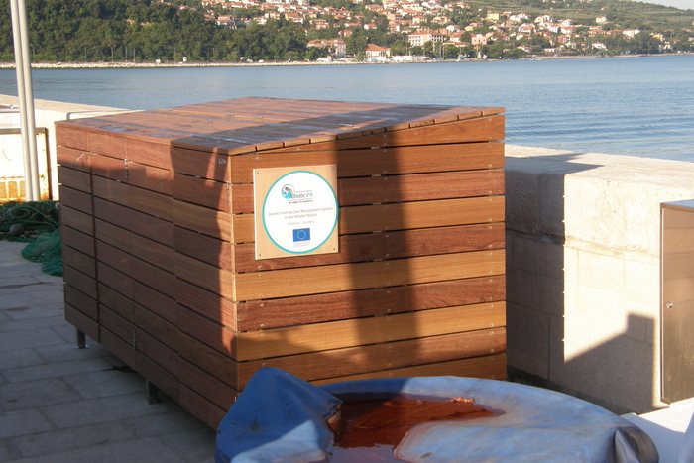
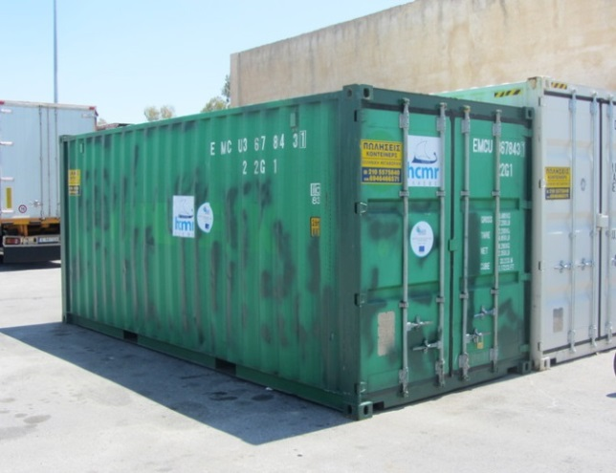
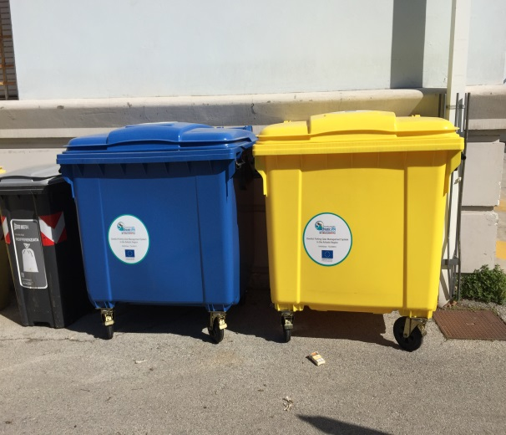
DeFishGear Fishing for litter and nets
Different containers for marine litter and nets (Italy, Slovenia, Croatia, Greece)

Slide 12
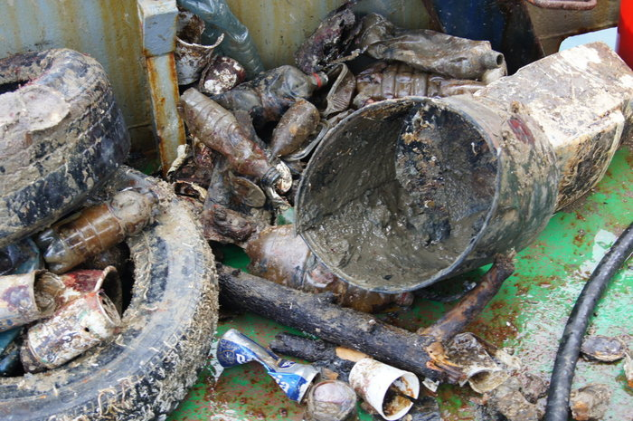
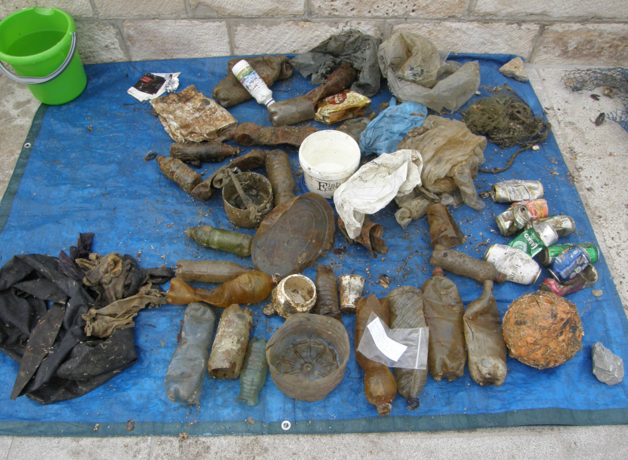
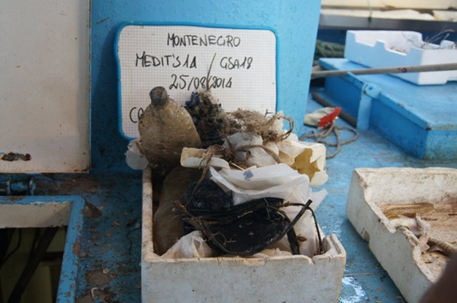
DeFishGear Fishing for litter and nets

Slide 13
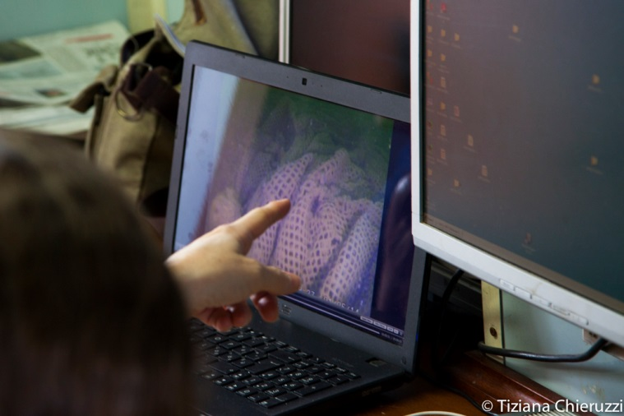
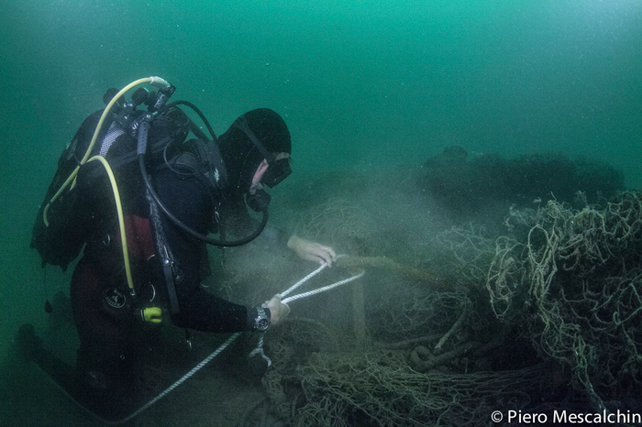
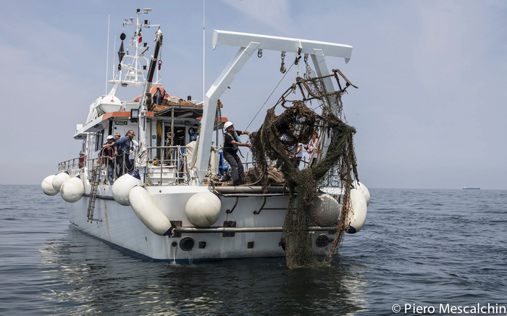
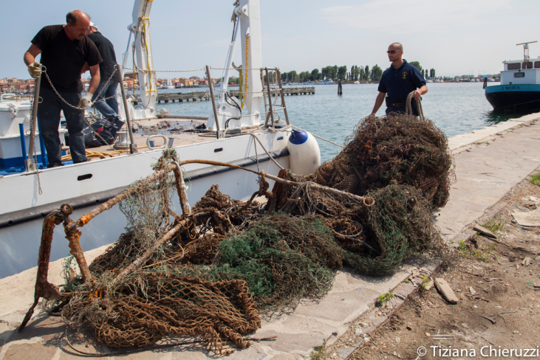
DeFishGear Ghost nets (ROV monitoring in Italy)

Slide 14
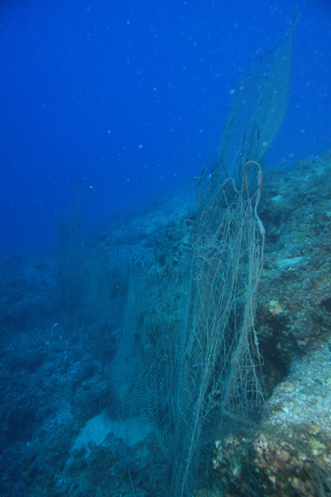
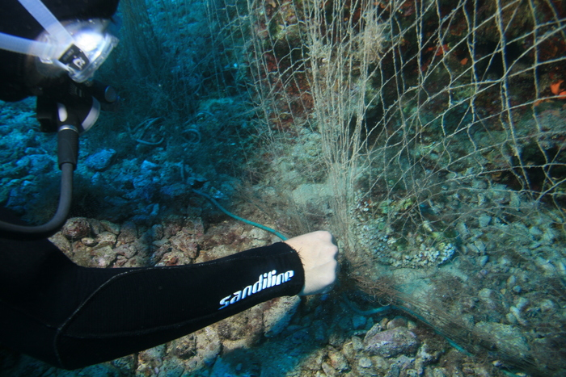
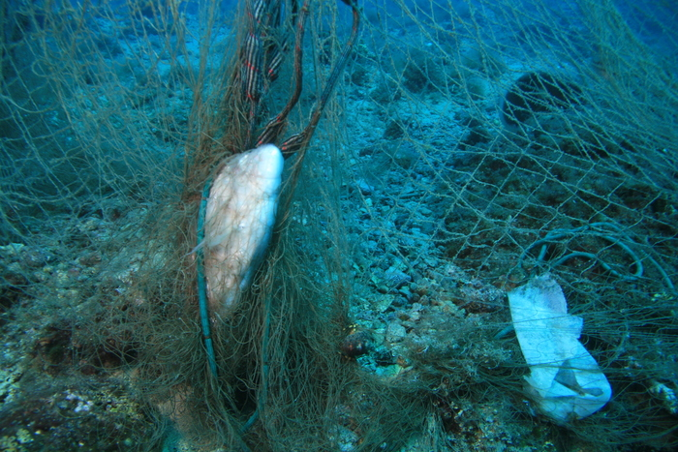
DeFishGear Ghost nets (ROV monitoring in Croatia)

Slide 15
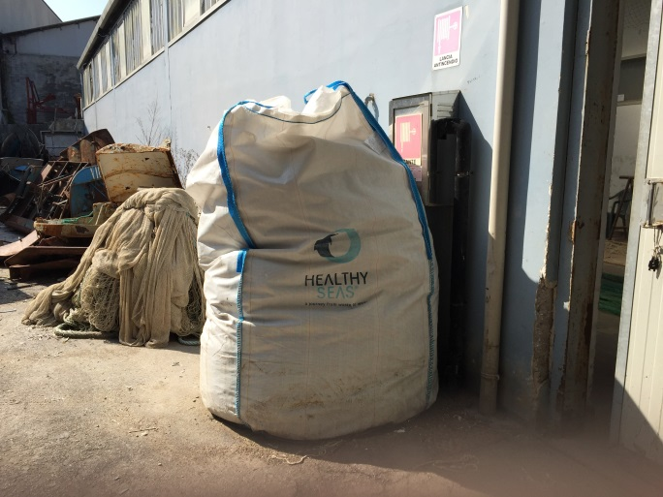
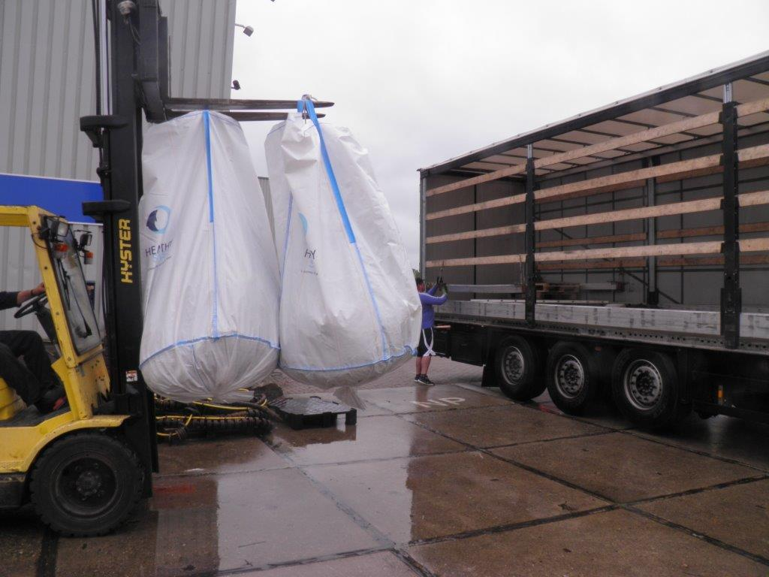
DeFishGear Fishing for litter and nets
  Collection of derelict nylon nets to be reclycled by Aquafil (HSI) to produce new nylon for carpets, socks and swimming cloths

Slide 16
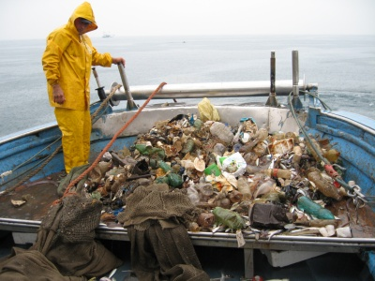
DeFishGear Problems
Problems linked to the management of litter/nets after collecting at sea.

Slide 17
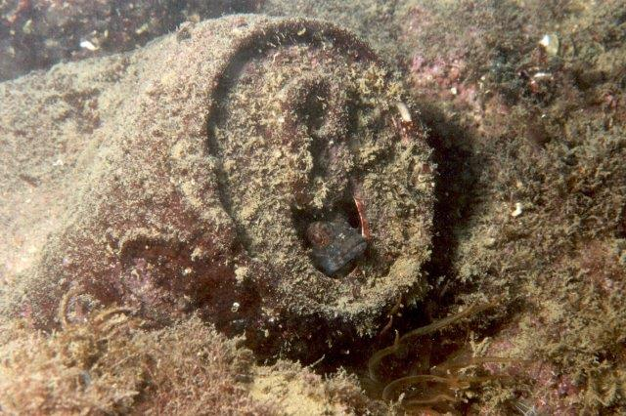
A special value comes from a specific action of involvement of the fishery sector, citizens and policy-makers, to contribute to change practices and culture.

Slide 18
Before…

Slide 19

After…

Slide 20
Thank you very much for your attention
- Fishing for litter pilot activities -
Paolo Pelusi
Mediterranean Consortium

