Slide 1
ML management within the MSFD framework: current status and recommendations
Ognjen Škunca
ognjen@irmo.hr
Conference on regional cooperation in Marine Litter management in Adriatic region, March 25th, 2015, Split, Croatia
IRMO

Slide 2
EU Marine Strategy Framework Directive (2008/56/EC) (MSFD)
GES, Descriptor 10:"Properties and quantities of marine litter do not cause harm to the coastal and marine environment."
Criteria | Indicator
10.1. Characteristics of litter in the marine and coastal environment | 10.1.1 Trends in the amount of litter washed ashore and/or deposited on coastlines, including analysis of its composition, spatial distribution and, where possible, source
 | 10.1.2 Trends in the amount of litter in the water column (including floating at the surface) and deposited on the sea- floor, including analysis of its composition, spatial distribution and, where possible, source
 | 10.1.3 Trends in the amount, distribution and, where possible, composition of micro-particles (in particular micro- plastics)
10.2. Impacts of litter on marine life | 10.2.1 Trends in the amount and composition of litter ingested by marine animals (e.g. stomach analysis)

Slide 3
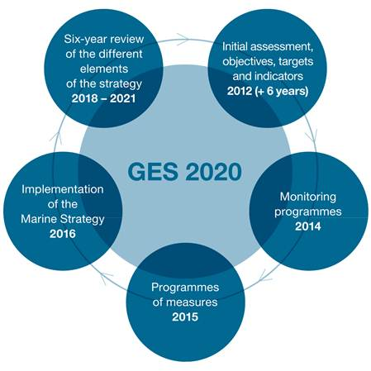
EU Marine Strategy Framework Directive (2008/56/EC) (MSFD)

Slide 4
European Commission’s Assessment and Guidance of the first phase of implementation of MSFD (February, 2014)
General assessment / comments:
important step forward, but significant shortcomings
significant differences in quality of reporting (across countries, across descriptors) … even the best-performing MS still have to address specific shortcomings
E.g.1: the logical link between the initial assessment (the point of departure), the determination of GES (the final objective) and the targets (the effort needed to reach the objective, starting from the point of departure) has not been recognized by all
E.g.2: insufficient regional cooperation … “regional cooperation must be at the very heart of MSFD implementation, and influence national implementation processes, rather than the other way around”

Slide 5
European Commission’s Assessment and Guidance of the first phase of implementation of MSFD (February, 2014) (cont.)
Regarding the GES descriptor 10:
… situation even less satisfactory than on average,
… due to the fact that ML issue has got due attention only recently; available data is scarce, spotty in time and spatial coverage,
… which does not allow sound determination of GES baselines and targets. …
harmonized monitoring which will allow gathering of reliable data on various aspects of ML issue is of the highest priority
“the need for a coordinated, consistent, coherent and comparable monitoring within marine regions, which can only take place through improved regional cooperation on monitoring”
ML has been singled out as one of the particular topics where more of the regional and sub-regional coordination is needed

Slide 6
Regional Plan on Marine Litter Management in the Mediterranean in the Framework of Article 15 of the Land Based Sources Protocol (adopted December 2013, in force since June 2014)
MEASURE | MSFD | MED RP
Assessment | 2012 | 2016
Monitoring | 2014 | 2017
Program of measures / Revision of LSB NAPs with integrated ML measures / considerations | 2015 | 2015
Implementation of measures | 2016 | 2017/2020
Programs of removal and environmentally sound disposal of existing marine litter; | 2016 | 2019
Awareness raising and education programs | 2015
Objective Good environmental status | 2020

