Slide 1
„Experiences with marine litter monitoring within the framework of DeFishGear project”
Association for Environment, Nature and Sustainable Development Sunce
Mosor Prvan

Slide 2
ABOUT US:
founded in 1998
one of the leading organizations for the protection of nature and environment in Croatia
present at national and international level (mainly in the region)
responsible waste management, efficient PA management, sustainable tourism in PAs, sustainable use of natural resources, conservation policy, environmental education,…

Slide 3
ROLE IN DEFISHGEAR PROJECT:
Contracted by IOF for WP 4 – Marine litter assessment
Marine litter monitoring (beaches, sea surface, sea bottom)
Volunteer mobilization and education
Public awareness raising (media, social media, video, posters,…)

Slide 4
MONITORING LOCATIONS:

Slide 5
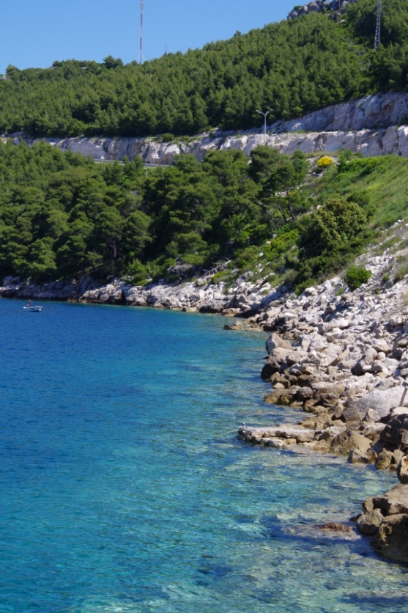
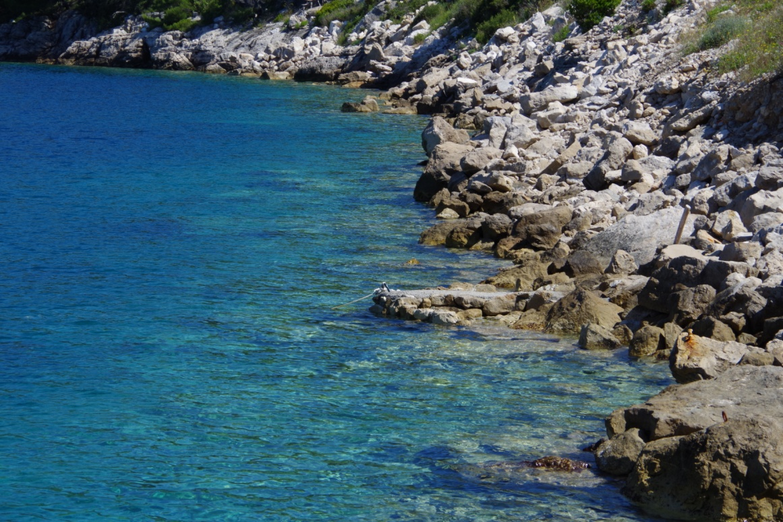
FIELD OBSERVATIONS AND REMARKS:
1. Limited beach selection in Croatia
95% of Croatian coast is rocky
Mostly short (under 100 m) and pebble beaches

Slide 6
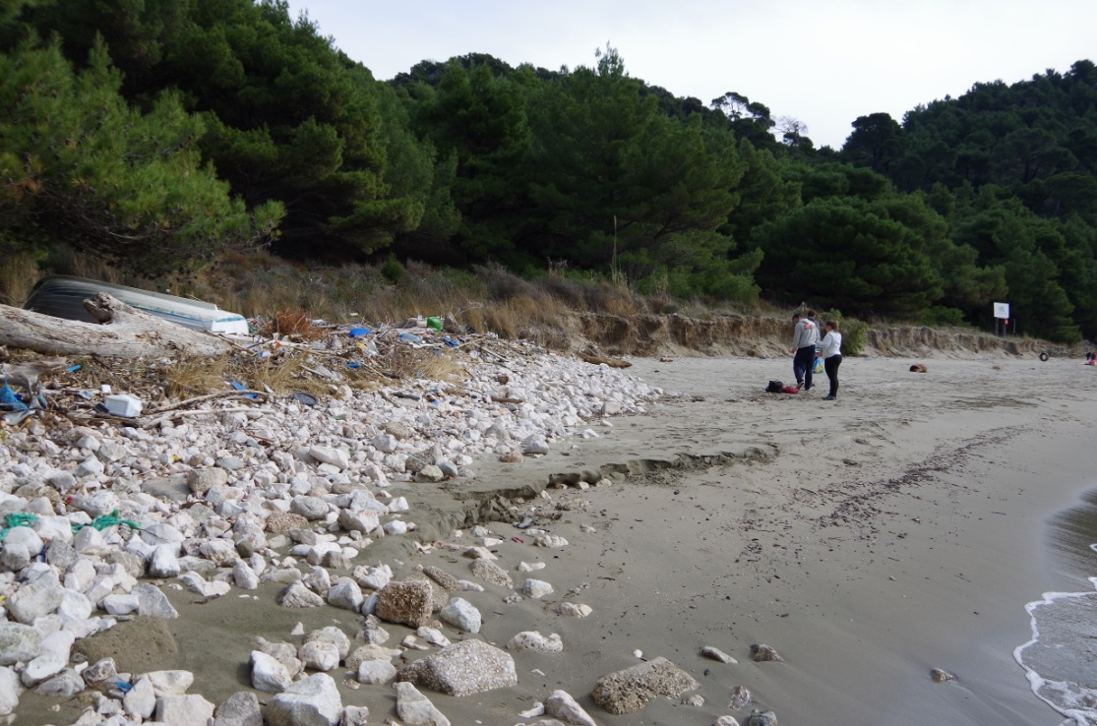
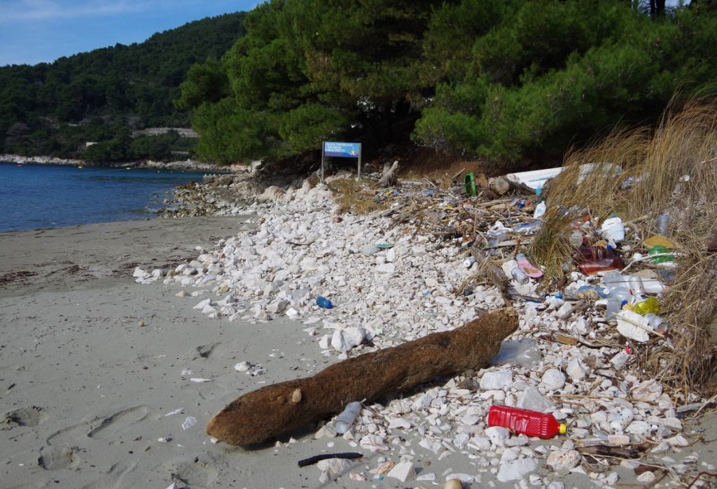
FIELD OBSERVATIONS AND REMARKS:
2. Acumulation of waste on certain positions along the beach
Mostly in corners (outside the transects) or on certain spots along the beach (which influences the results if only 1m transects are done)

Slide 7
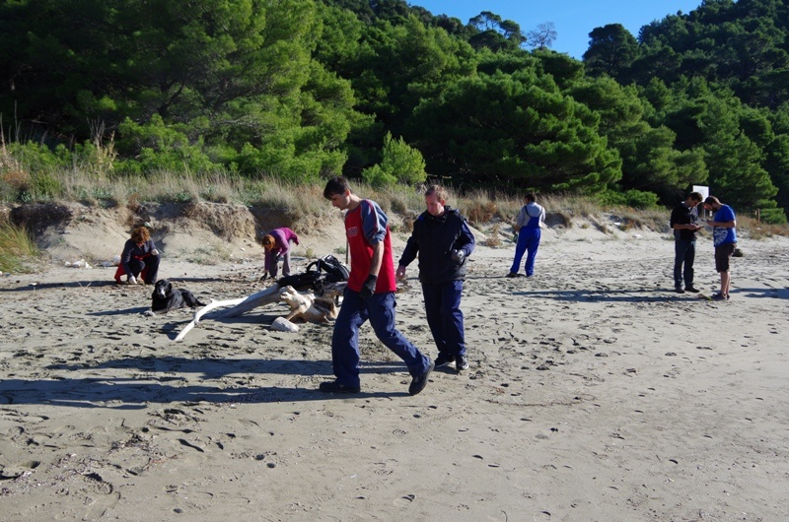
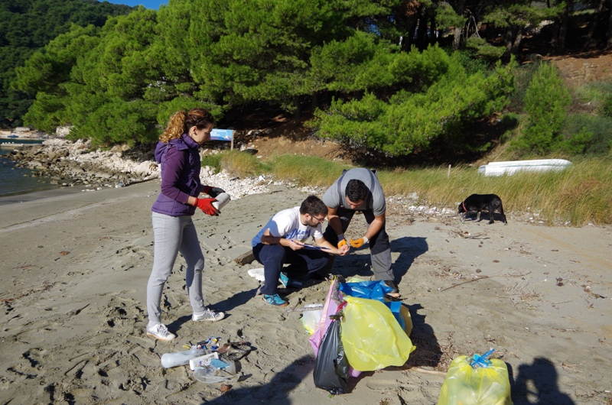
FIELD OBSERVATIONS AND REMARKS:
3. Long term volunteer mobilization is questionable

Slide 8
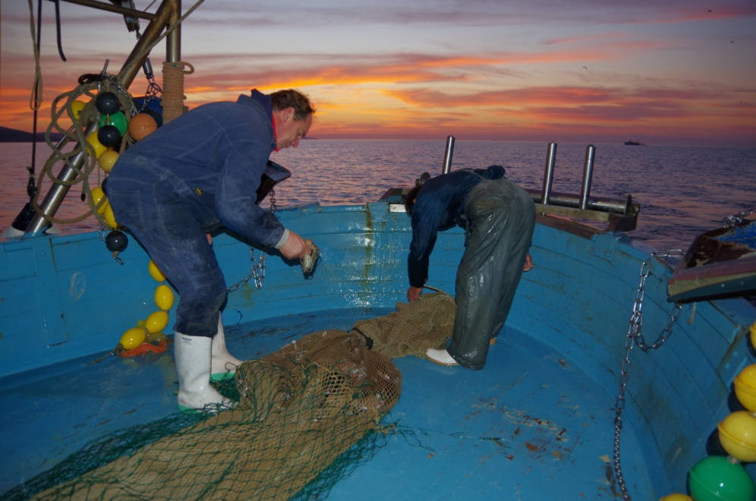
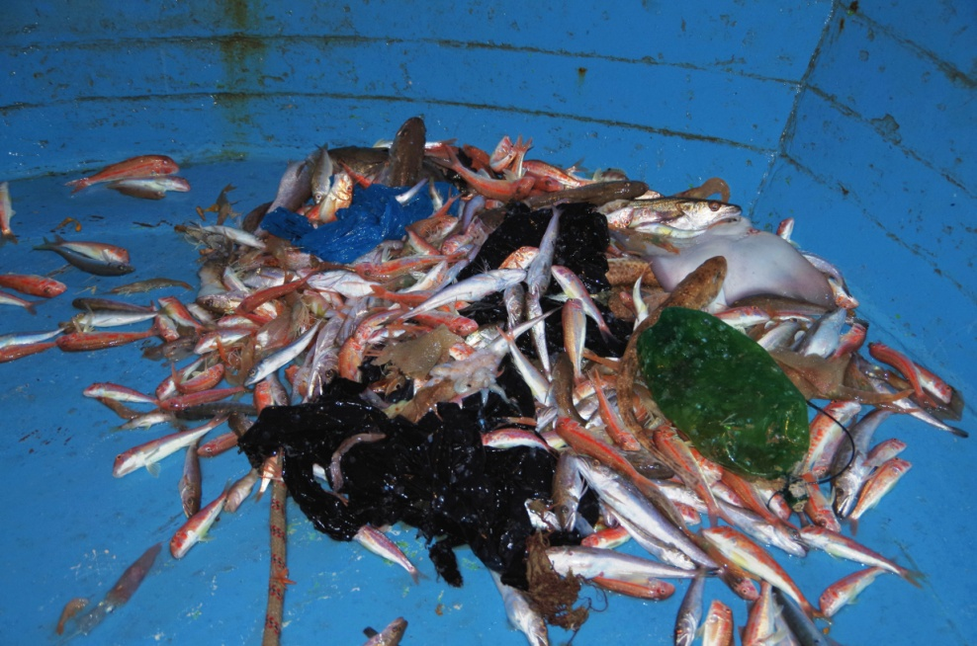
FIELD OBSERVATIONS AND REMARKS:
4. Working with trawlers (marine bottom litter monitoring)
We are bounded by fishery law – operating only on fishing grounds – litter removed by trawlers on daily basis

Slide 9
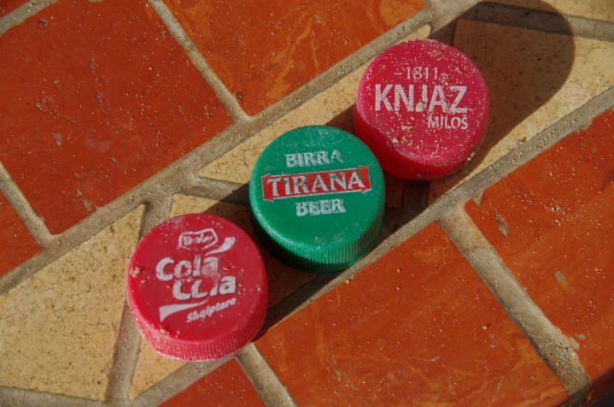
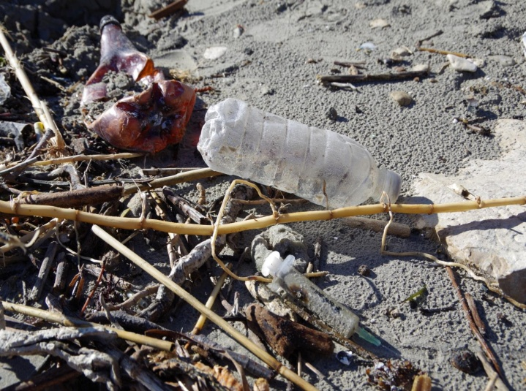
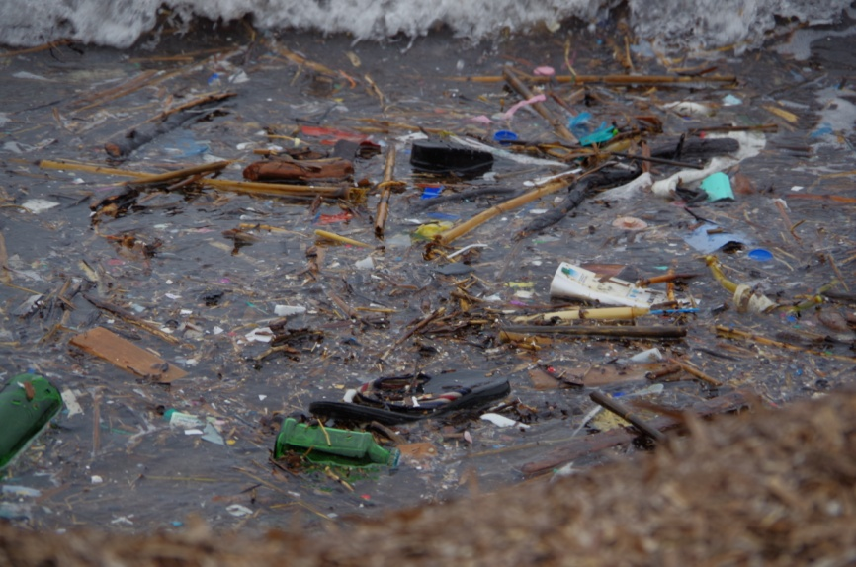
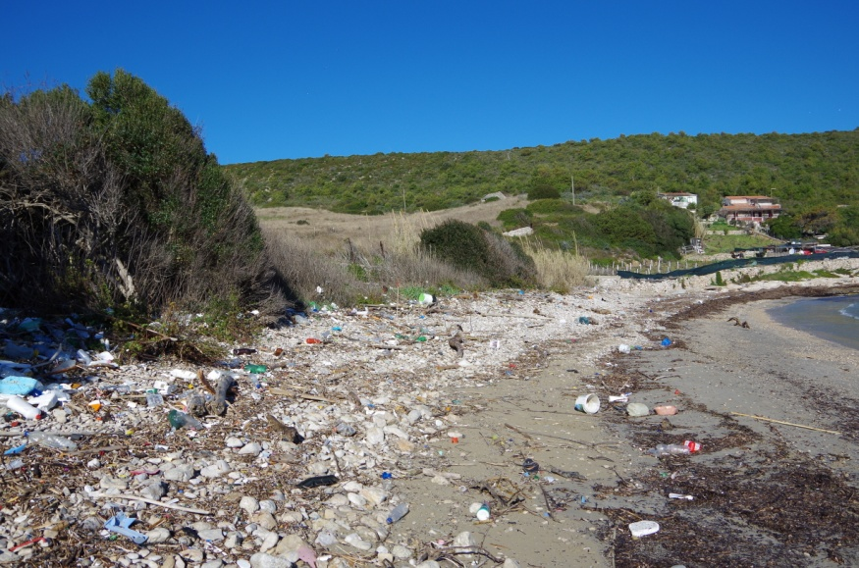
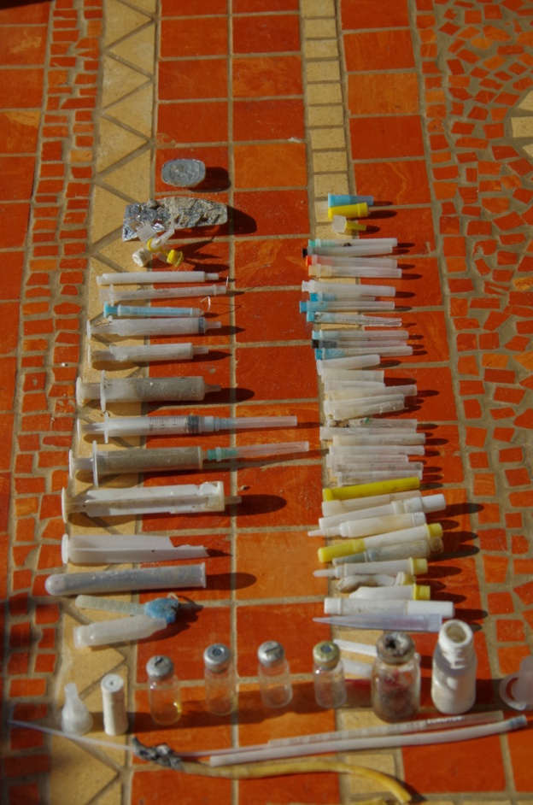
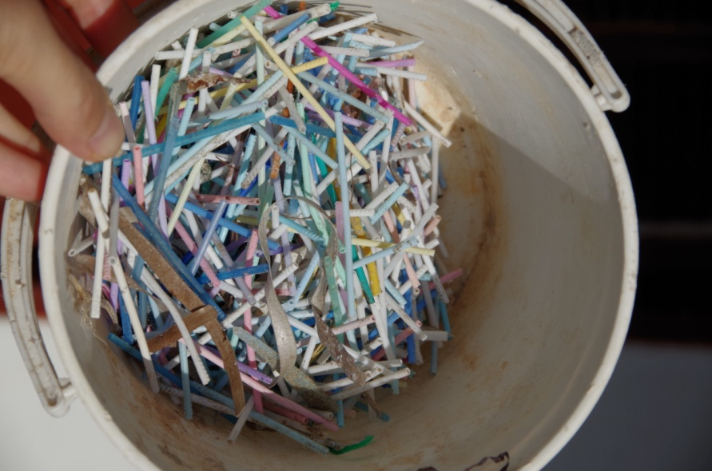
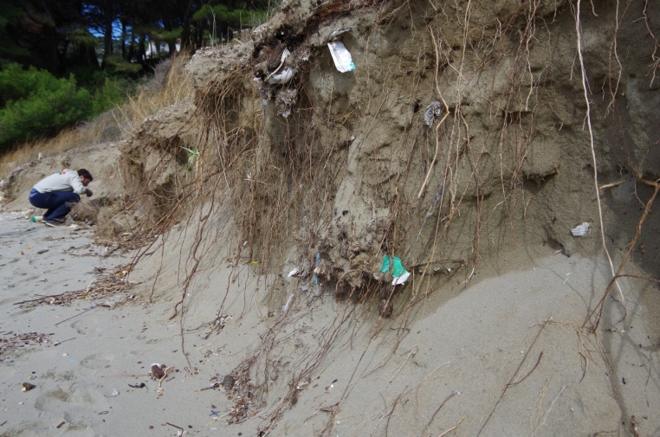
THANK YOU!

